Slide 1
Digital Image Processing
Digitization

Slide 2
Summery of previous lecture
Need for the digitization
To digitize the image
Sampling
Quantization
How to digitize an image?
Sampling of 1 dimensional signal f (t)
We learn to use the Fourier transform to find out the bandwidth or the frequency spectrum of 1 dimensional signal f (t) if its periodic signal and if f (t) is an aperiodic signal

Slide 3
Todays lecture
Frequency spectrum of an image
Explain the sampling of the 2 dimension image
The second stage of the digitization process.
In the first sampling and in the second quantization of each of the samples.
Optimum mean square error or Lloyd-max quantizer.
Designing of an optimum quantizer with the given signal probability density function.

Slide 4
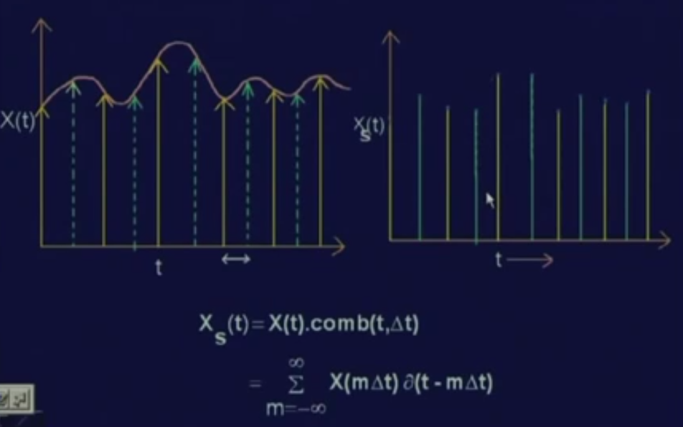
Theory of sampling

Slide 5
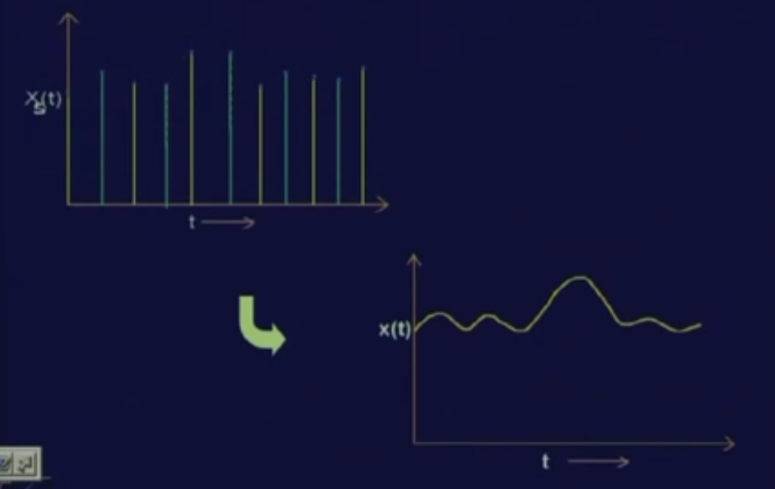
Sampling from signal
The sampling will be proper if its to be reconstruct the original continuous signal X (t) from these sampled values
For that needs to maintain certain conditions so that the reconstruction of the analog signal X (t) is possible.

Slide 6
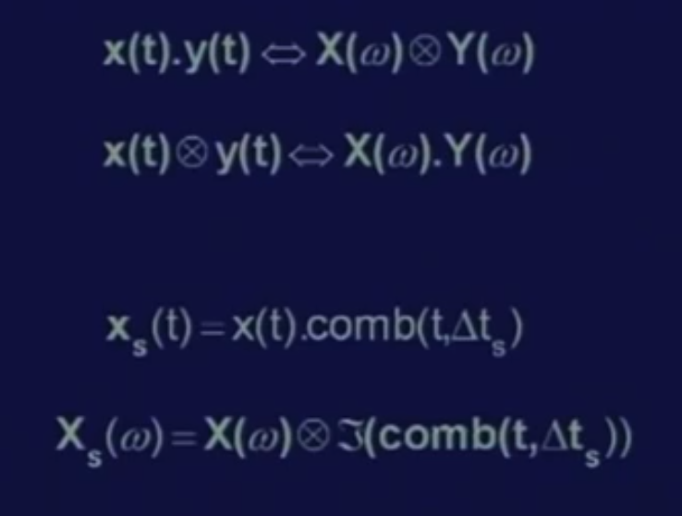
Convolution Theorem
if we have 2 signals X (t) and y (t) in time domain, then the multiplication of X (t) and y (t) in time domain is equivalent to the convolution of the frequency spectrum of X (t) and frequency spectrum of y (t) in the frequency domain, that is X (t) into y (t) is equivalent to X omega convoluted with Y omega.

Slide 7
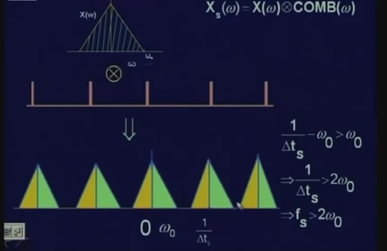
X omega is the frequency spectrum or the bandwidth of the signal, a frequency spectrum of the signal which is presented here and this is the frequency spectrum of the
sampling function;
these 2 are convolute, where the original frequency spectrum of the signal gets replicated along the frequency axis at an interval of 1 upon delta tS where 1 upon delta tS is nothing but the sampling frequency f of s.

Slide 8
For proper reconstruction, we the original spectrum,
And to take the original spectrum we need to take it out with a filter a particular band and the remaining frequency components will simply be discarded.
For the filtering operation to be successful, we need 1 upon delta tS minus omega naught where omega naught is the bandwidth of the signal or the maximum frequency component present in the signal X (t).
^{1 upon delta t}_{s} minus omega naught must be greater than or equal to omega naught and that leads to the condition that the sampling frequency f _{S} must be greater than twice of omega naught where omega naught is the bandwidth of the signal and this is the Nyquist rate.

Slide 9
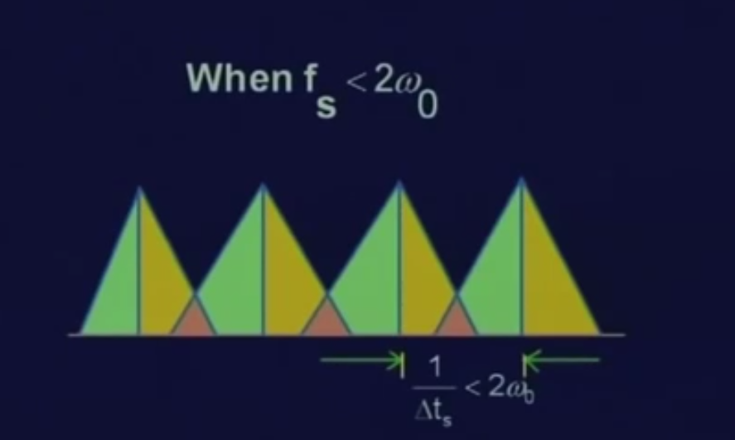
Aliasing
What happens if the sampling frequency is less than twice of omega naught?
In that case you find that subsequent frequency bands after sampling overlap and because of this overlapping, a single frequency band cannot be extracted using any of the low pass filters.

Slide 10
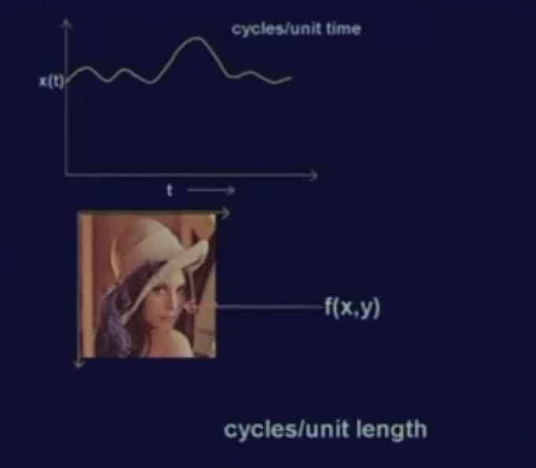
2D image sampling
if t is time, in that case X (t) is a signal which varies with time and for such a signal, the frequency is measured as you know in terms of hertz which is nothing but cycles per unit time.
how do you measure the frequency in case of an image?
In case of an image, the dimension is represented by 5 centimeter by 5 centimeter or 10 centimeter by 10 centimeter etc.
The image, can be measure in the frequency; cycles per unit length

Slide 11
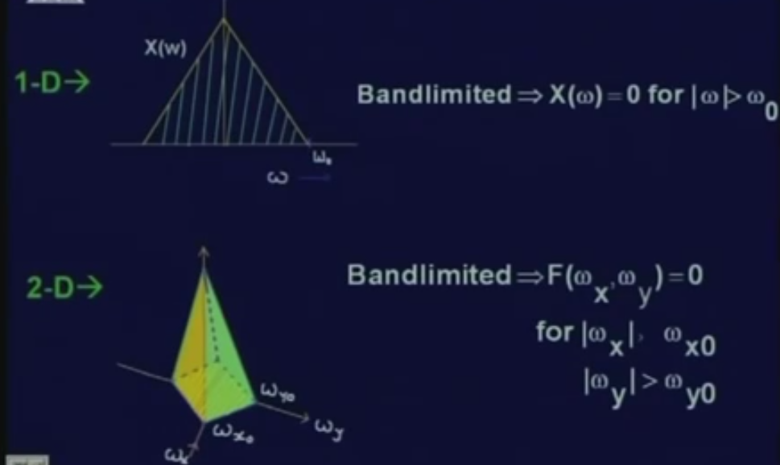
2D image sampling
signal X (t), is the frequency spectrum represented by X of omega and the signal X (t) is band limited if X of omega is equal to 0 for omega is greater than omega naught where omega naught is the bandwidth of the signal X (t).
in case of an image, the frequency of 2 components
one in the x direction
other in the y direction. Which is, omega x and omega y.
band limited if f of omega x omega y is equal to 0 for omega x greater than omega x0 and omega y greater than omega y0.
In this case, the maximum frequency component in the x direction is omega x0 and the maximum frequency component in the y direction is omega y0.

Slide 12
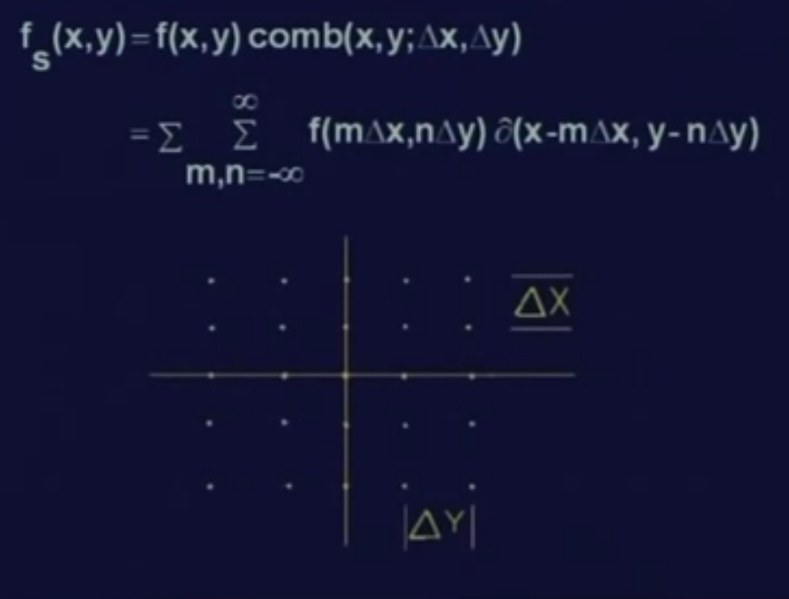
2D image sampling
2 variables x and y is nothing but a 2 dimensional array of the delta functions where along x direction, the spacing is delta x and along y direction, the spacing is delta y.

Slide 13
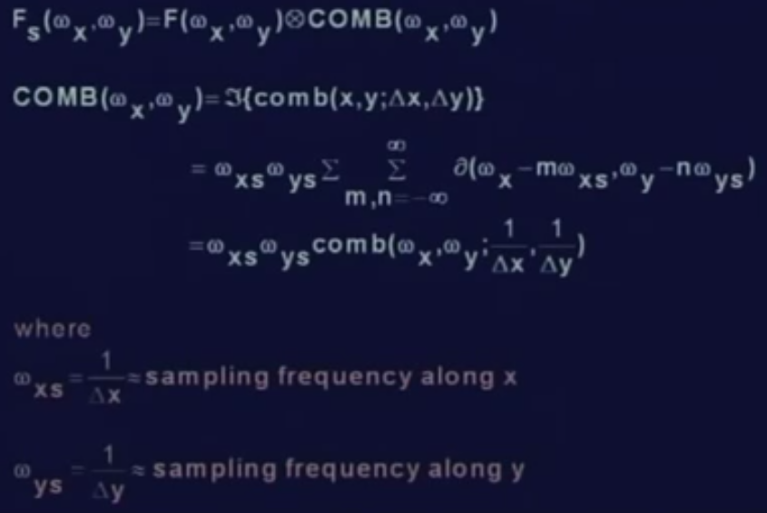
2D image sampling
Same as 1 dimensional signal; to find the frequency spectrum of the sampled image,
Convoluted with comb
Comb is Fourier transform of omega xs omega ys
Where omega xs is 1 by delta x

Slide 14
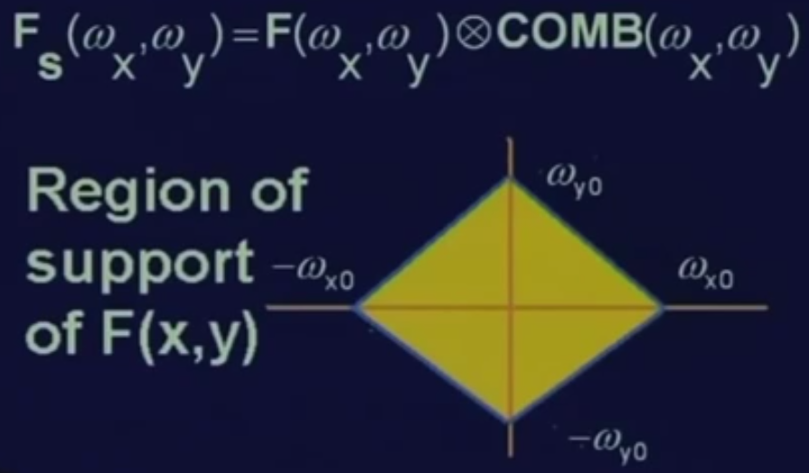
2D image sampling
FS (omega x omega y) which is the convolution of (F omega x omega y) “which is the frequency spectrum of the original image” convoluted with comb (omega x omega y) “which is the Fourier transform of the sampling function in 2 dimension”
The convolution operation replicates the original frequency spectrum in omega axis in case of 1 dimensional signal;
in case of 2-dimensional signal this will be replicated, along both x direction and y direction.

Slide 15
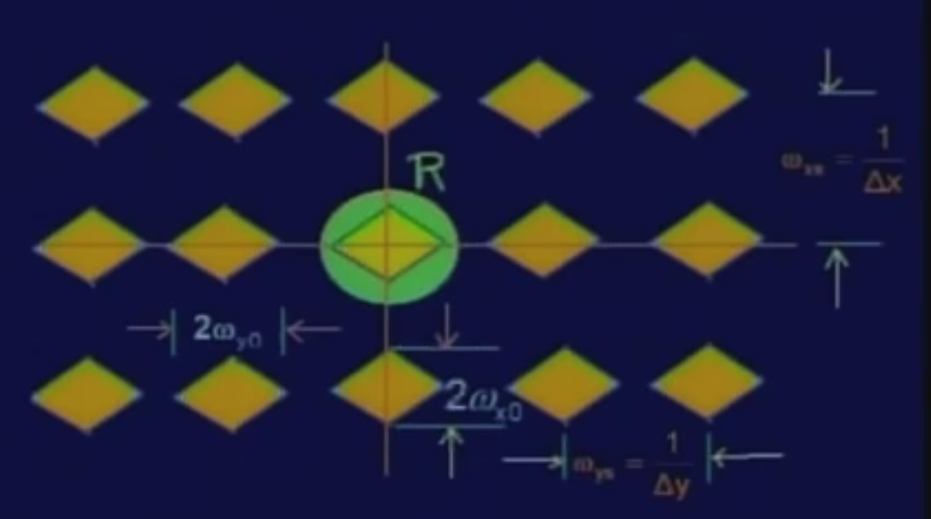
2D image sampling
We get 2-dimensional array of the spectrum of the image
So here again, we find out that the region of support getting replicated along y direction and along x direction
The spacing between 2 subsequent frequency band along the x direction is equal
to omega xs which is 1 upon delta x and
along y direction, the spacing is 1 upon delta y which is nothing but omega ys and that is the sampling frequency along the y direction.

Slide 16
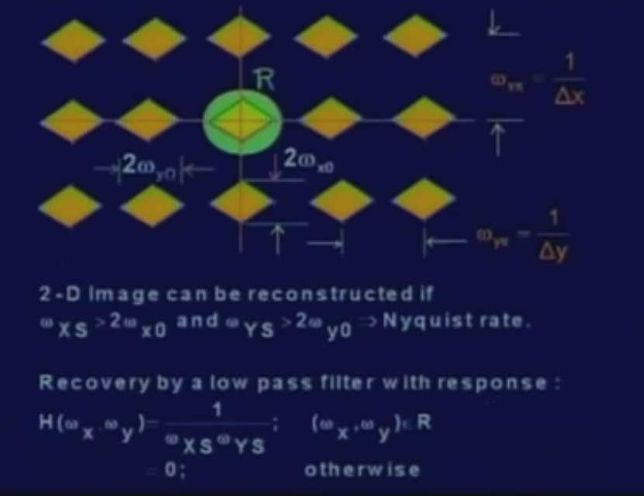
Reconstruction of the original image from spectrum
We need to take out a particular frequency band
For that that the signal has pass through a low pass filter whose response is given by H (omega x omega y) is equal to 1 upon omega xs into omega ys for omega x omega y in the region R where region R just covers this central band and it is equal to 0 outside this region R.
For the low pass filter the same condition of the Nyquist rate applies.
That is sampling frequency in the x direction must be greater than twice of omega x naught “which is the maximum frequency component along x”
And the sampling frequency along y direction has to be greater than twice of omega y naught “which is the maximum frequency component along direction y “

Slide 17
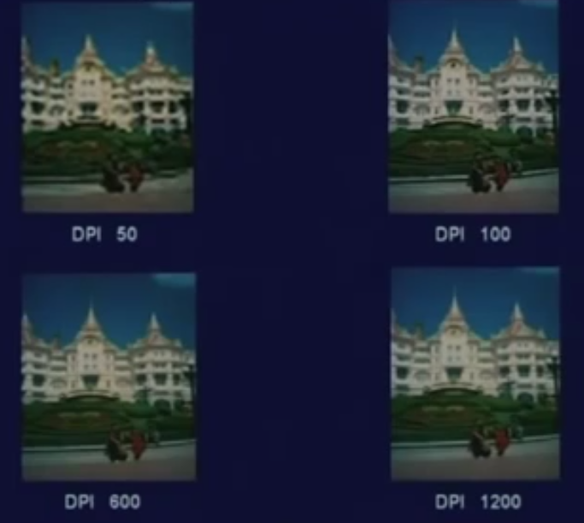
Results
sampled with 50 dots per inch or 50 samples per inch and so on
When your sampling frequency is above the Nyquist rate, you are not going to get any improvement of the image quality.
Whereas, when it is less than the Nyquist rate, image is very bad.

Slide 18
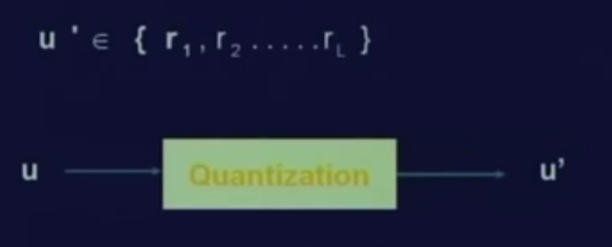
Quantization of the sampled values
Quantization is a mapping of the continuous variable u to a discrete variable u prime
Where u prime takes values from a set of discrete variable r1 to rL.

Slide 19
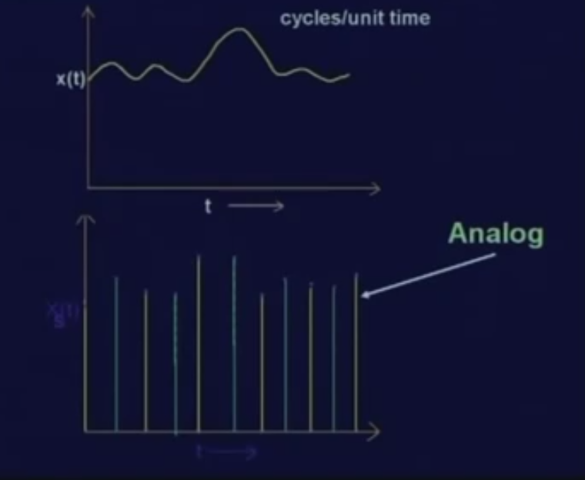
Quantization of the sampled values
By Sampling of a continuous signal, we get discrete samples in time domain. But still, every sample value is an analog value; it is not a discrete value.
Which means the signal values at all possible time instants; we have considered only the discrete time instants and at each of this discrete time instants, the value of this sample is still an analog value.

Slide 20
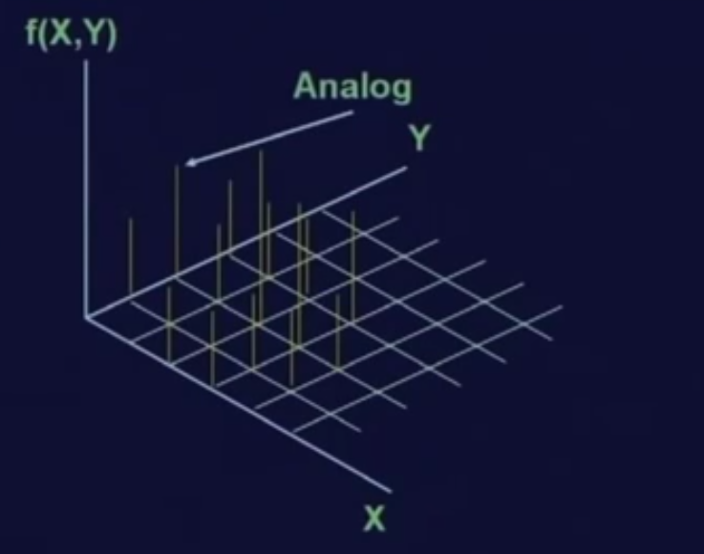
In Image
In case of an image, the sampling is done in 2 dimensional grids where at each of the grid locations, a sample value is analog.
If I want to represent a sample value in a digital computer, then this analog sample value cannot be represented.
So, we need quantization for this purpose.

Slide 21
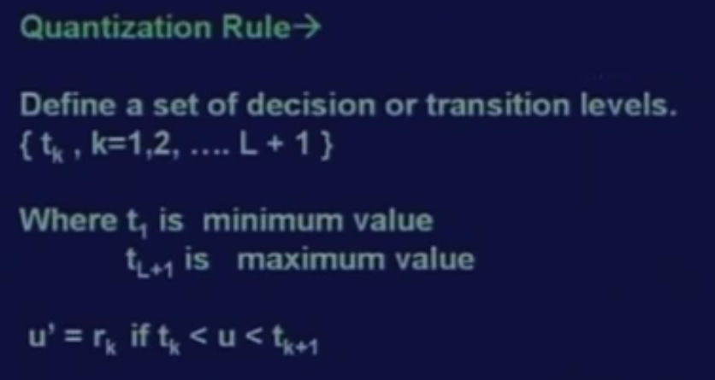
Staircase function
The quantization is a mapping which is generally a staircase function.
We define a set of decision or transition levels which is transition level tk where k varies from 1 to L plus 1.
And also defined a set of the reconstruction levels that is rk.

Slide 22
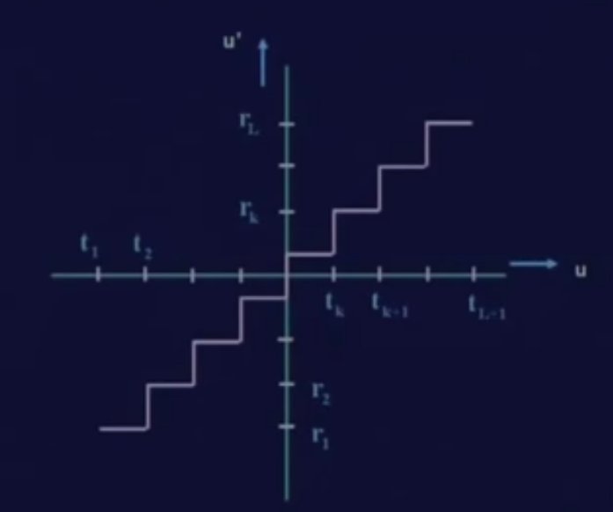
input output relationship of a quantizer
By input signal u, along the horizontal direction and along the vertical direction the output signal u prime which is the quantized signal.
If input signal u lies between the transition levels t1 and t2; then the reconstructed signal or the quantized signal will take a value r1.
If the input signal lies between t2 and t3, the reconstructed signal or the quantized signal will take a value r2.
Similarly, if the input signal lies between tk and tk plus 1, then the reconstructed signal will take the value of rk and so on.
The input signal is analog in nature and the output signal is discrete. So, the output signal can take only one of these discrete values, the output signal cannot take any arbitrary value.

Slide 23
Error in reconstruction
Ideally whatever the input signal is given, the output signal should be same as the input signal and that is necessary for a perfect reconstruction of the signal.
But we know that for quantization, your output signal is one of the discrete set of values which is not always the same as the input signal.
By staircase function, there is always some error in the output signal or in the quantized signal.
Lets see that what is the nature of this error.

Slide 24
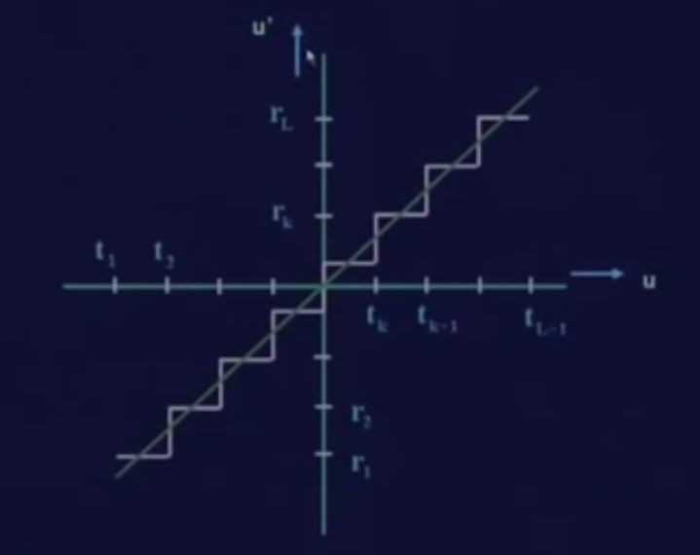
Error in reconstruction
The line inclined at 45 degree with the u axis crosses the staircase function; whatever is the signal value, it is the reconstructed value.
But in case of quantization, we take the discrete value which is between t1 and tk which the error introduced

Slide 25
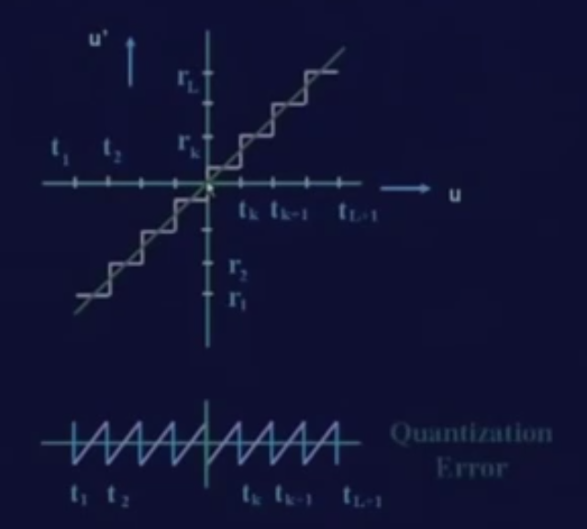
Error in quantized signal
Only at these cross over points, the error in the quantized signal will be 0. At all other points, the error in the quantized signal will be a non-zero value.
By plotting this quantization error, between every transition levels.
t1 and t2 the error value continuously increases,
t2 and t3 the error continuously increases,
What is the effect of this error on the reconstructed signal?

Slide 26
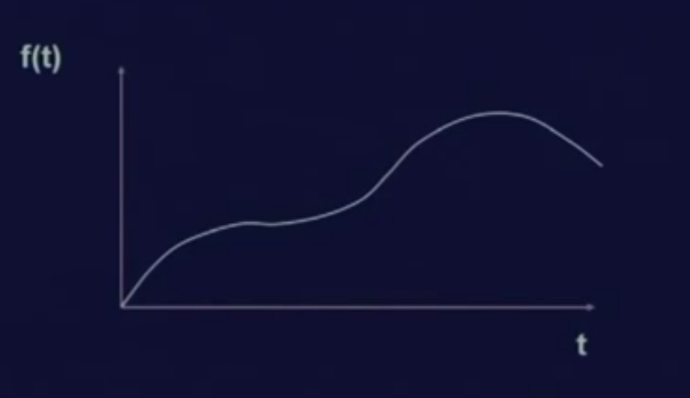
Effect of error
1 dimensional signal f (t) which is a function of t
Lets see the effect of quantization on the reconstructed signal.

Slide 27
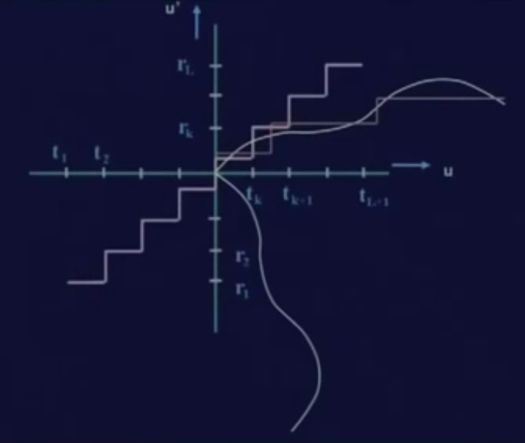
Effect of error
signal is plotted in the vertical direction so that we can see the transition levels
If the input signal lies between the transition levels tk minus 1 and tk; the corresponding reconstructed signal will be rk minus 1.

Slide 28
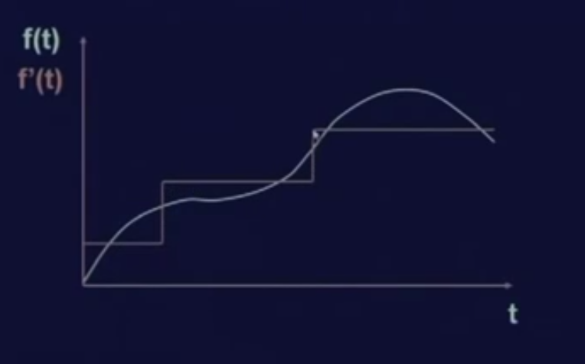
Quantization error or quantization noise
To have a clear figure, you find that in this, the green curve is the original input signal and the red staircase lines, staircase functions, quantized signal or f at f prime t.
we can not get the original signal from the quantized signal because within the region, the signal can have any arbitrary value and the details of that are lost in the quantized output.
The quantization error can be reduced if the quantizer step size that is the transition intervals say tk to tk plus 1 reduces; similarly, the reconstruction step size rk to rk plus 1 that interval is also reduced.

Slide 29
Lloyd-Max quantizer
For the quantizer designer it will be to minimize this quantization error.
So we have to have an optimum quantizer and this optimum mean square error quantizer known as Lloyd-Max quantizer
Which is to minimizes the mean square error for a given number of quantization levels

Slide 30
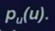
Lloyd-Max quantizer
Assume that u be a real scalar random variable with a continuous probability density function pu of u
and it is desired to find the decision levels tk and the reconstruction levels rk for L level quantizer which is to minimize the quantization noise or quantization error.

Slide 31
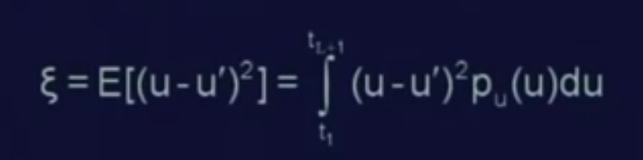
Mean square error
You remember that u is the input signal and u prime is the quantized signal.
So, the error of reconstruction is the input signal minus the reconstructed signal.
The mean square error is given by the expected value of u minus u prime square and this value is
Integrate from t1 to tL plus 1 u minus u Prime Square multiplied by the probability density function of (u) du

Slide 32
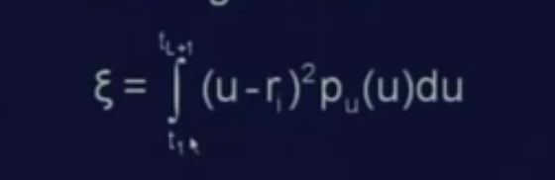
Mean square error
u minus ri square where ri is the reconstruction level or the reconstructed signal in the interval ti to ti plus 1.
This shows the square error of the reconstructed signal and the purpose of designing the quantizer will be to minimize this error value.
I+1

Slide 33
Minimization problem
In Mathematics when there is the minimization problem, we need to differentiate the error function, the error value with tk and with rk and equating those equations to 0.

Slide 34
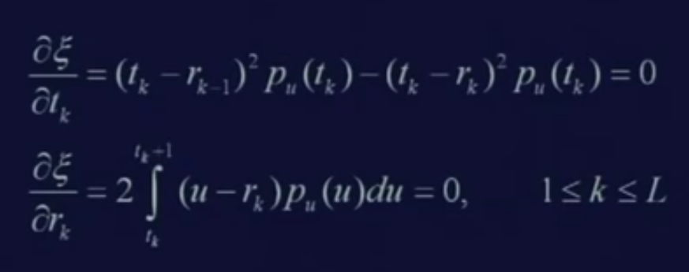
Differentiate the error value
To differentiate the error value
We get is zeta is the error value del zeta del tk is same as tk minus rk minus 1 square pu tk minus tk minus rk square pu tk and these has to be equated to 0.
Similarly, the second equation - del zeta del rk will be same as twice into integral u minus rk pu(u) du equal to 0 where the integration has to be taken from tk to tk plus 1.

Slide 35
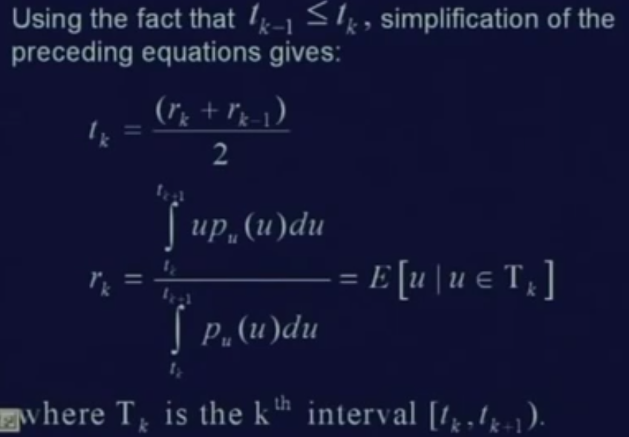
by solving these 2 equations and using the fact that tk minus 1 is less than tk;
we get 2 values
One is for transition level
and the other one is the for the reconstruction level.
What do we get from the 2 equations?

Slide 36
optimum quantizer or the Lloyd-Max quantizer
Optimum transition level tk lie halfway between the optimum reconstruction levels.
Its obvious because tk is equal to rk plus rk minus 1 by 2.
The transition level lies halfway between rk and rk minus 1
The second observation is that the optimum reconstruction levels in turn lie at the center of mass of the probability density in between the transition levels;
Which is given by the second equation
So, this is nothing but the center of mass of the probability density between the interval tk and tk plus 1.

Slide 37
these 2 equations are non linear equations
To solve non linear equations with the help of Newton iterative method
if the number of quantization levels is very large; we can approximate pu (u) the probability density function as piecewise constant function.

Slide 38
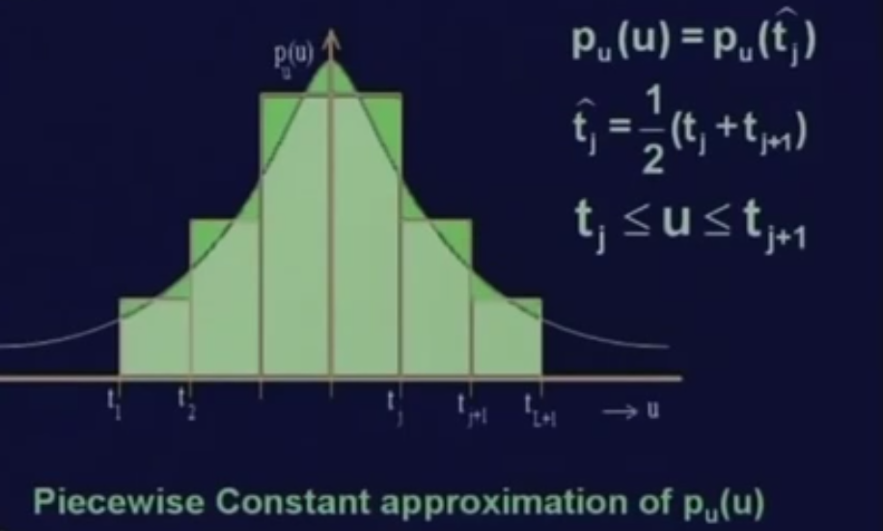
Piecewise constant approximation
The Probability density function like a Gaussian function.
We can approximate it in between the levels (tj and tj plus 1), we have the mean value of this as tj hat which is halfway between tj and tj plus 1
we can approximate pu (u) where pu (u) is actually a nonlinear one, we can approximate this as pu (tj hat).
In between tj and tj plus 1 that is in between every 2 transition levels, we approximate the probability density function to be a constant one which is same as the probability density function at the halfway between these 2 transition levels.

Slide 39
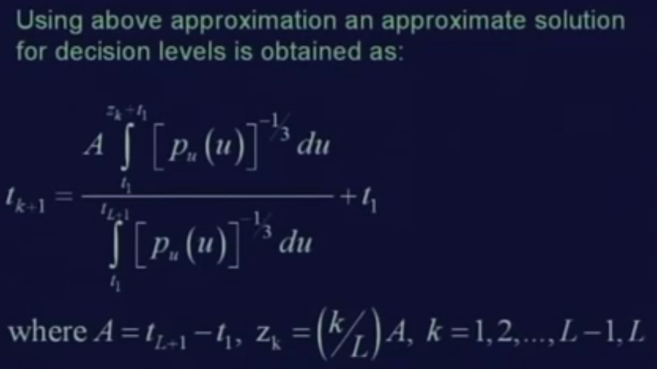
if I use the approximation and recomputed the values, we will find that tk plus 1 can now be computed as
for solving this particular equation, the requirement is that t1 and tL plus 1 to be finite. That is the minimum transition level and the maximum transition level, they must be finite.
At the same time, we have to assume t1 and tL plus 1 a before placement of decision and reconstruction levels.

Slide 40
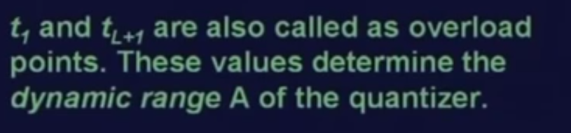
Overload points
This t1 and tL plus 1 are also called overload points
These 2 values determine the dynamic range A of the quantizer.
So, if you find that when we have a fixed t1 and tL plus 1; then any value less than t1 or any value greater than tL plus 1, they cannot be properly quantized by this quantizer.
This represents that what is the dynamic range of the quantizer.

Slide 41
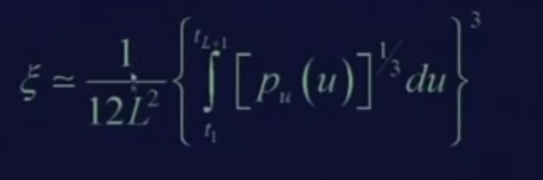
quantization mean square error
Once we get the transition levels, then we can find out the reconstruction levels by averaging the subsequent transition levels.
So, once we have the reconstruction levels and the transition levels, then the quantization mean square error can be computed as this.
This expression gives an estimate of the quantizer error in terms of probability density and the number of quantization levels.

Slide 42
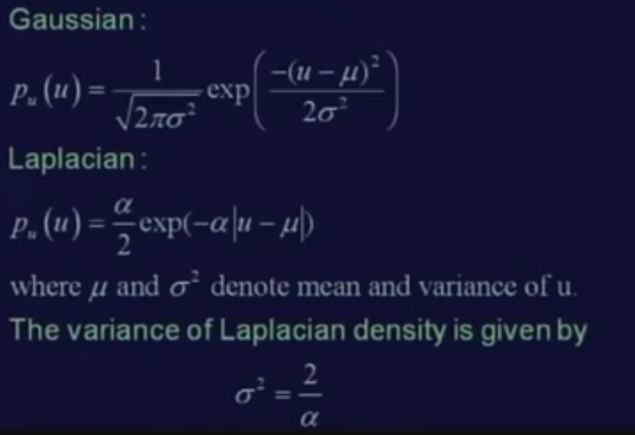
Probability density functions

Slide 43
Sum-up
For uniform distributions, the Lloyd-Max quantizer equations becomes linear because all the equation that we have derived earlier they are all linear equations giving equal intervals between ransition levels and the reconstruction levels and so this is also sometimes referred as a linear quantizer.
We know sample a signal in 1 dimension, how to sample an image in 2 dimension.
We have also seen that after you get the sample values where each of the sample values are analog in nature; how to quantize those sample value so that you can get the exact digital signal as well as exact digital image

Slide 44
References
Prof .P. K. Biswas Department of Electronics and Electrical Communication Engineering Indian Institute of Technology, Kharagpur
Gonzalez R. C. & Woods R.E. (2008). Digital Image Processing. Prentice Hall.
Forsyth, D. A. & Ponce, J. (2011).Computer Vision: A Modern Approach. Pearson Education.

